Slide 1
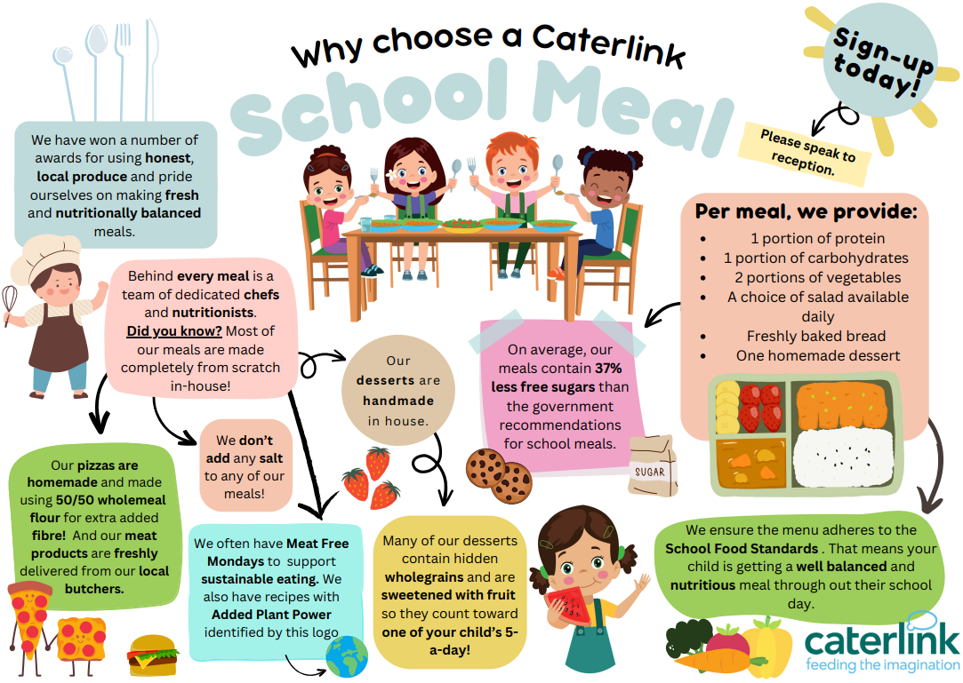

Slide 2
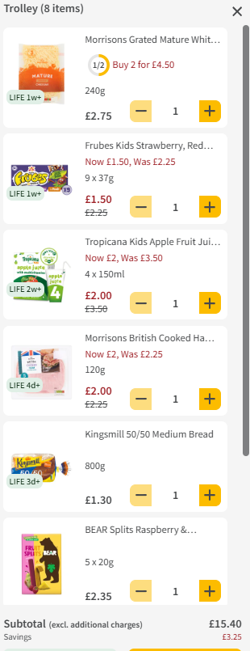
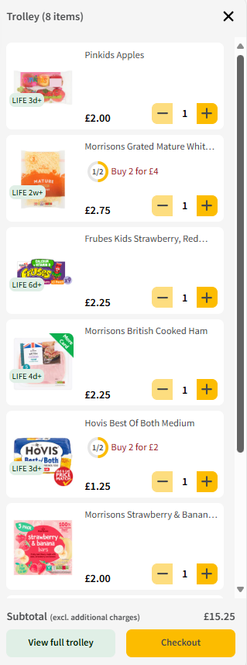

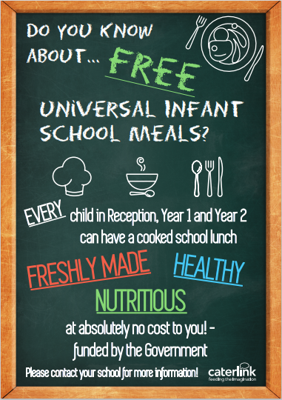
£15.40 per week x 38 school weeks = £585.20 annually!!
The Average basket cost for a daily packed lunch – Based on Morrisons on 23 March 2026
Basket contains, Bread, Ham, Cheese, Yoghurt, fruit bars, apples, juice carton and pom bears

